Slide 1



Slide 2



01CE1301 – Data Structure
Unit - 3
Non-Linear Data Structure
(Part 02 – Tree)
Prof. Chirag Bhalodia
Department of Computer Engineering

Slide 3


Outline
Tree definitions and their concepts
Representation of binary tree
Binary tree traversal methods (inorder, postorder, preorder)
Binary search trees
Method to Convert a general tree to binary tree
Threaded binary tree
Balanced tree and its mechanism
AVL tree
B Tree and B+ Tree
Application of Tree

Slide 4

Tree Definition & their concepts

Slide 5
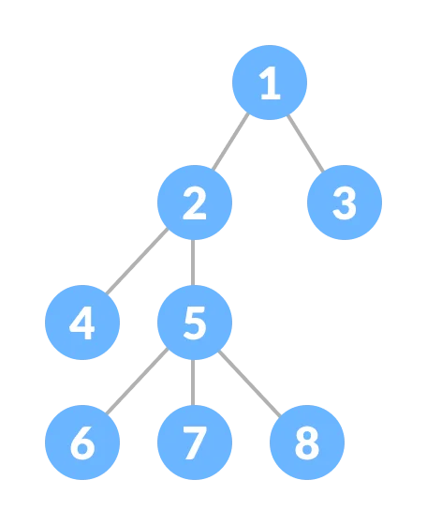
Tree definitions & their concepts
What is Tree?
A tree is a nonlinear hierarchical data structure that consists of nodes connected by edges.
Tree is a collection of nodes that are connected by edges and has a hierarchical relationship between the nodes.

Slide 6
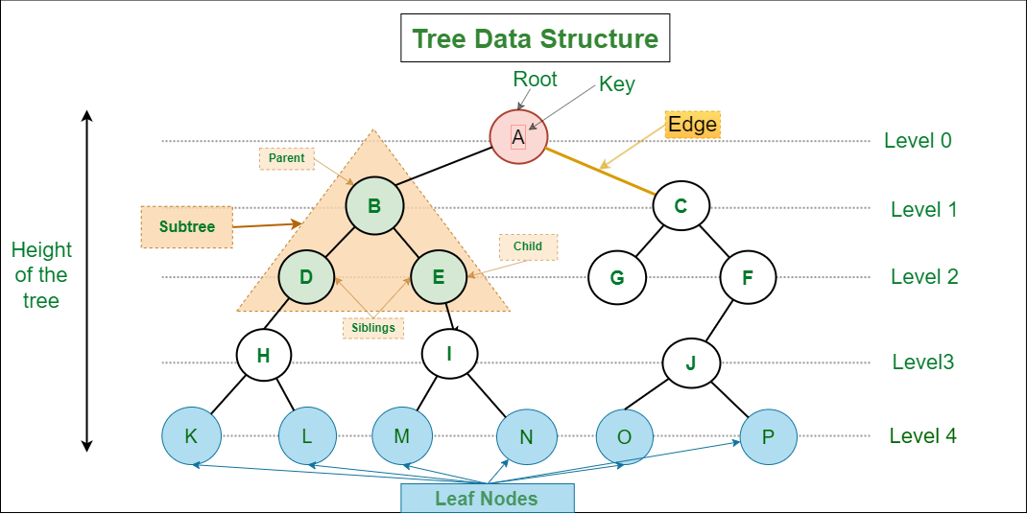
Tree definitions & their concepts
Basic Terminology
Root Node: The topmost node of a tree or the node which does not have any parent node is called the root node. {A} is the root node of the tree. A non-empty tree must contain exactly one root node and exactly one path from the root to all other nodes of the tree.
Parent Node: The node which is a predecessor of a node is called the parent node of that node. {B} is the parent node of {D, E}.
Child Node: The node which is the immediate successor of a node is called the child node of that node. Examples: {D, E} are the child nodes of {B}.

Slide 7
Tree definitions & their concepts
Basic Terminology
Leaf Node or External Node: The nodes which do not have any child nodes are called leaf nodes. {K, L, M, N, O, P} are the leaf nodes of the tree.
Ancestor of a Node: Any predecessor nodes on the path of the root to that node are called Ancestors of that node. {A,B} are the ancestor nodes of the node {E}
Descendant: Any successor node on the path from the leaf node to that node. {E,I} are the descendants of the node {B}.
Sibling: Children of the same parent node are called siblings. {D,E} are called siblings.

Slide 8
Tree definitions & their concepts
Basic Terminology
Internal node: A node with at least one child is called Internal Node.
Neighbour of a Node: Parent or child nodes of that node are called neighbors of that node.
Subtree: Any node of the tree along with its descendant.
Level of a node: The count of edges on the path from the root node to that node. The root node has level 0.

Slide 9
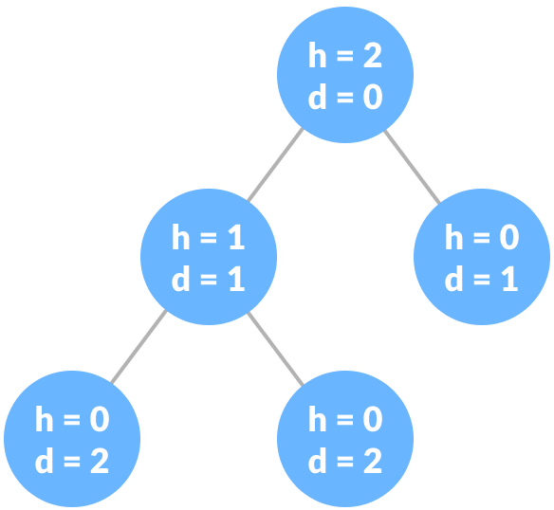
Tree definitions & their concepts
Basic Terminology
Height of a Node: The height of a node is the number of edges from the node to the deepest leaf (ie. the longest path from the node to a leaf node).
Depth of a Node: The depth of a node is the number of edges from the root to the node.
Height of a Tree: The height of a Tree is the height of the root node or the depth of the deepest node.

Slide 10

Tree definitions & their concepts
What we learn Tree?
Other data structures such as arrays, linked list, stack, and queue are linear data structures that store data sequentially. In order to perform any operation in a linear data structure, the time complexity increases with the increase in the data size. But, it is not acceptable in today's computational world.
Different tree data structures allow quicker and easier access to the data as it is a non-linear data structure.

Slide 11
Representation of Binary Tree

Slide 12
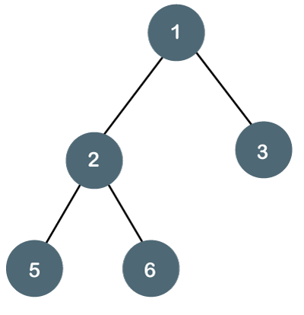
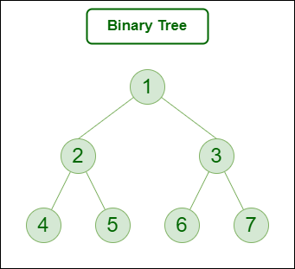
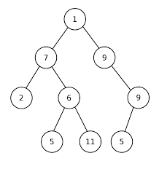
Representation of Binary Tree
What is Binary Tree?
The Binary tree means that the node can have maximum two children.
Here, binary name itself suggests that 'two'; therefore, each node can have either 0, 1 or 2 children.
Example of Binary Tree:

Slide 13
Representation of Binary Tree
Types of Binary Tree
Full Binary Tree
Complete Binary Tree
Perfect Binary Tree
Balanced Binary Tree

Slide 14
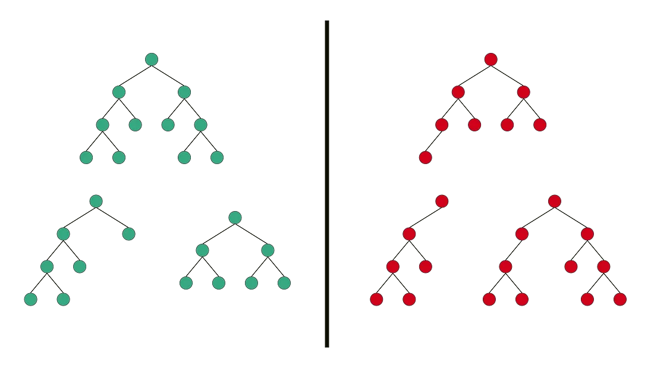
Representation of Binary Tree
Full Binary Tree: Full Binary Tree is a Binary Tree in which every node has 0 or 2 children.
Example:
Valid
Invalid

Slide 15
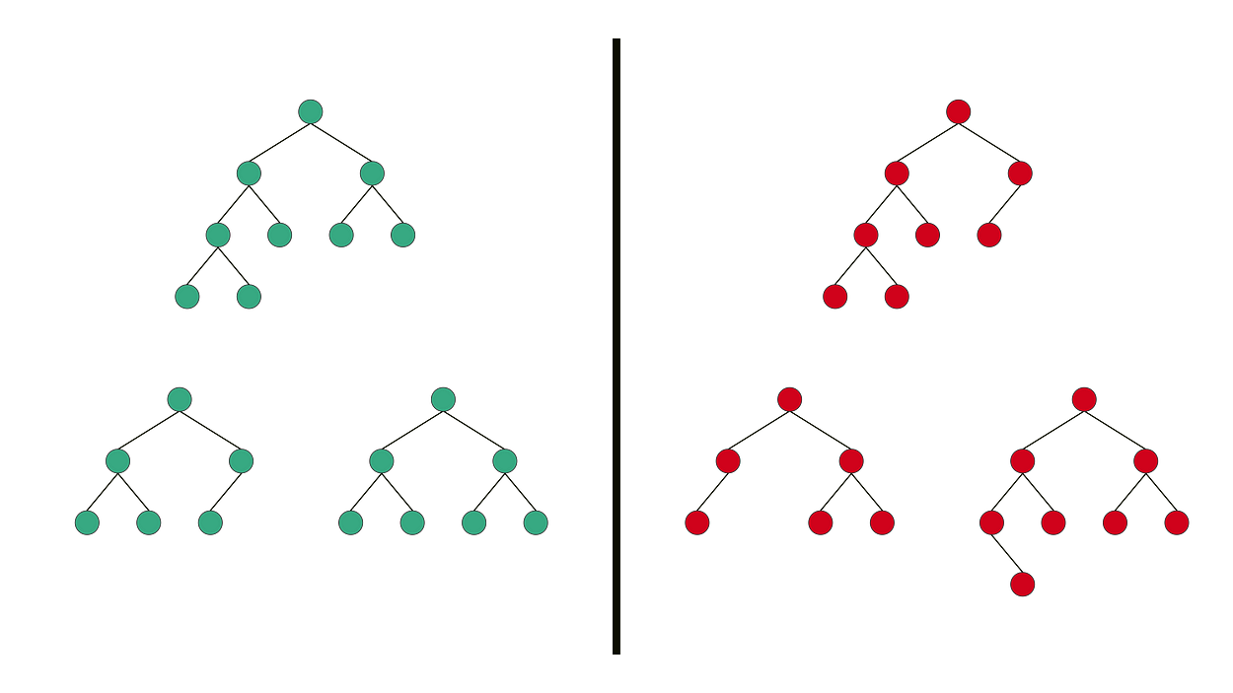
Representation of Binary Tree
Complete Binary Tree: Complete Binary Tree has all levels completely filled with nodes except the last level and in the last level, all the nodes are as left side as possible.
Example:
Valid
Invalid

Slide 16
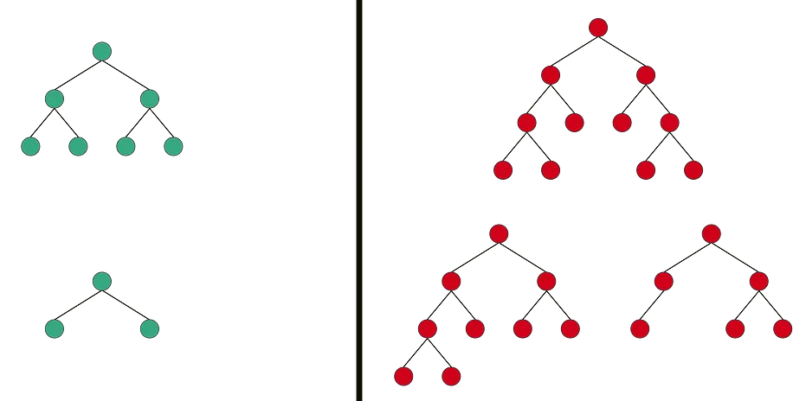
Representation of Binary Tree
Perfect Binary Tree: Perfect Binary Tree is a Binary Tree in which all internal nodes have 2 children and all the leaf nodes are at the same level.
Example:
Valid
Invalid

Slide 17
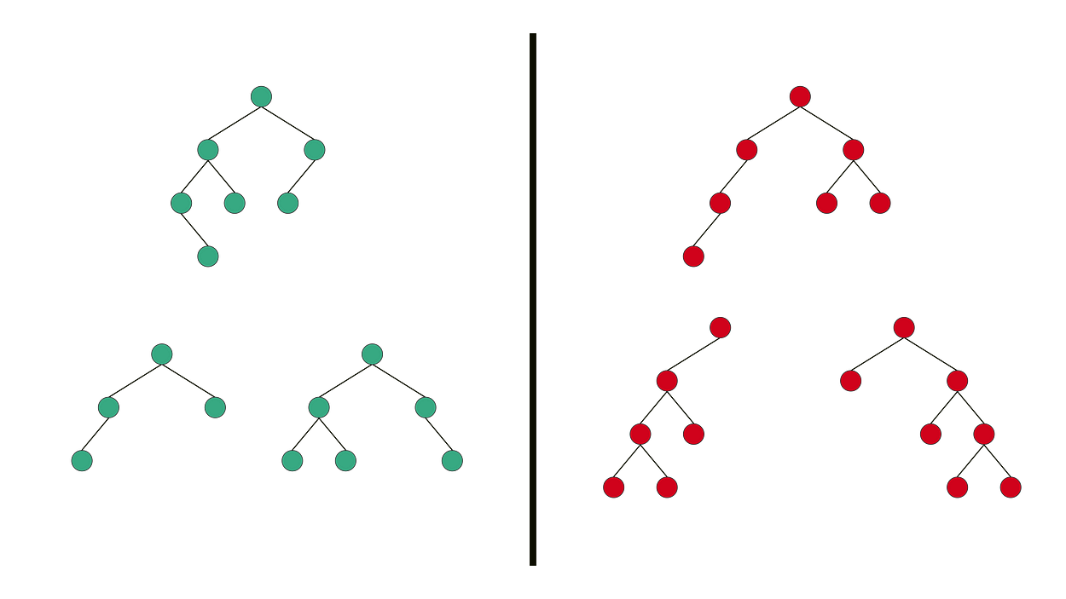
Representation of Binary Tree
Balanced Binary Tree: Balanced Binary Tree is a Binary tree in which height of the left and the right sub-trees of every node may differ by at most 1.
Example:
Valid
Invalid

Slide 18
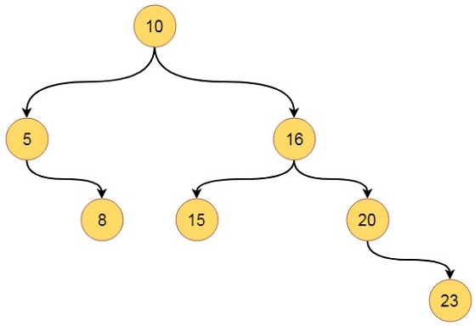
Representation of Binary Tree
Binary Tree Representation using Array
Index
1 | 2 | 3 | 4 | 5 | 6 | 7 | 8 | 9 | 10 | 11 | 12 | 13 | 14 | 15
10 | 5 | 16 | - | 8 | 15 | 20 | - | - | - | - | - | - | - | 23
Nodes

Slide 19
Representation of Binary Tree
Binary Tree Representation using Linked List
T
LPTR
DATA
RPTR
Typical node of Binary Tree
A
A
B
D
B
D
C
E
G
C
E
G
F
F

Slide 20
Representation of Binary Tree
Basic operations perform on Binary Tree
Create – create a tree in the data structure.
Insert − Inserts data in a tree.
Search − Searches specific data in a tree to check whether it is present or not.
Traversal:
Preorder Traversal – perform Traveling a tree in a pre-order manner in the data structure.
In order Traversal – perform Traveling a tree in an in-order manner.
Post-order Traversal –perform Traveling a tree in a post-order manner.

Slide 21
Binary Search Tree

Slide 22
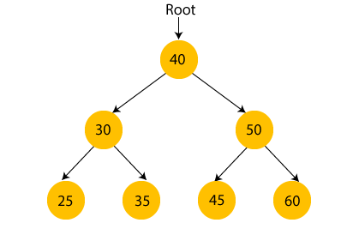
Binary Search Tree
What is Binary Search Tree?
In a Binary search tree, the value of left node must be smaller than the parent node, and the value of right node must be greater than the parent node.
This rule is applied recursively to the left and right subtrees of the root.

Slide 23
Binary Search Tree
Construct binary search tree for the following data 50 , 25 , 75 , 22 , 40 , 60 , 80 , 90 , 15 , 30
50
25
75
22
40
60
80
15
30
90
Construct binary search tree for the following data 10, 3, 15, 22, 6, 45, 65, 23, 78, 34, 5

Slide 24
Binary Search Tree
10
3
15
6
22
5
45
23
65
Construct binary search tree for the following data 10, 3, 15, 22, 6, 45, 65, 23, 78, 34, 5
34
78

Slide 25
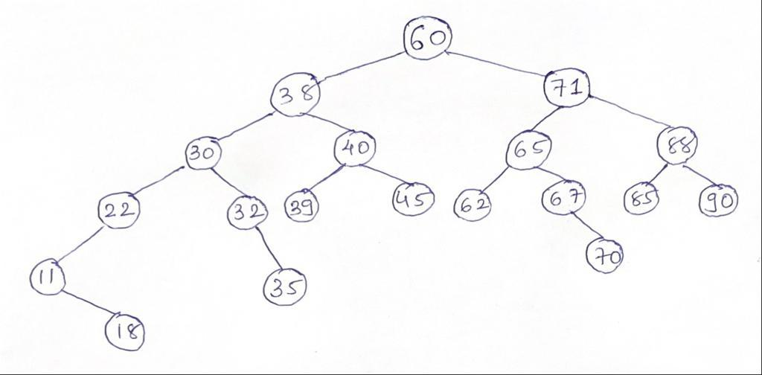
Binary Search Tree
Construct a binary search tree from following data
60 38 71 30 40 65 88 22 32 39 45 62 67 85 90 11 18 35 70

Slide 26
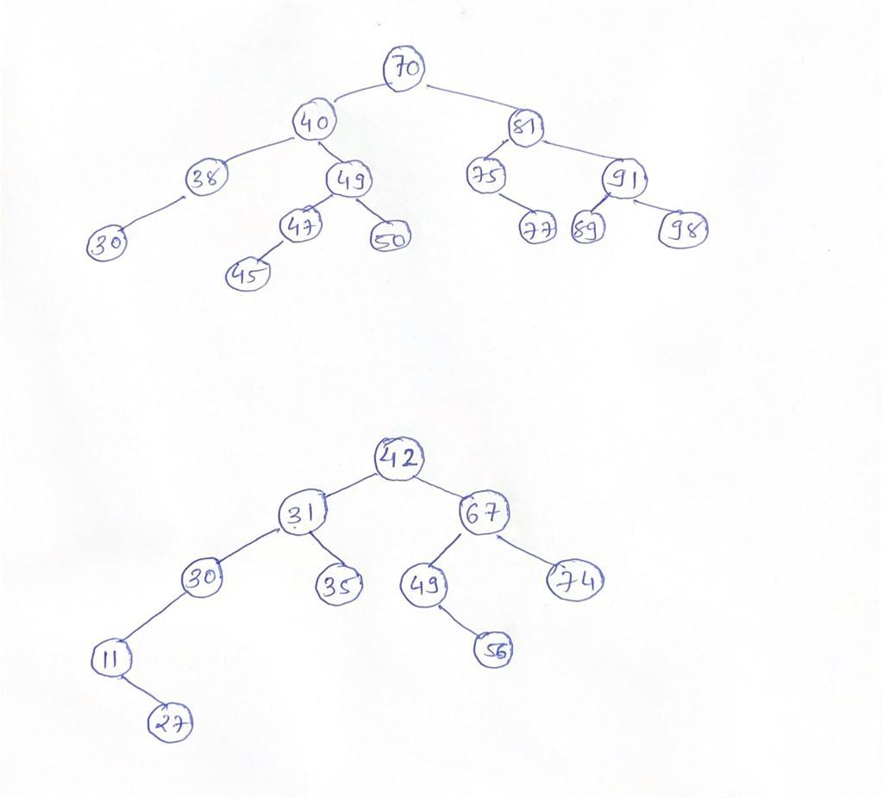
Binary Search Tree
Construct a binary search tree from following data
70 40 81 38 49 75 91 30 47 50 77 89 98 45

Slide 27
Binary Search Tree
Construct a binary search tree from following data
42 31 67 30 11 35 49 27 74 56

Slide 28
Binary Search Tree
Search a node in BST (Searching)
First, compare the element to be searched with the root element of the tree.
If root is matched with the target element, then return the node's location.
If it is not matched, then check whether the item is less than the root element, if it is smaller than the root element, then move to the left subtree.
If it is larger than the root element, then move to the right subtree.
Repeat the above procedure recursively until the match is found.
If the element is not found or not present in the tree, then return NULL.

Slide 29
Binary Search Tree
Algorithm of Search a Node in BST
If (root == NULL)
return NULL;
If (number == root->data)
return root->data;
If (number < root->data)
return search(root->left)
If (number > root->data)
return search(root->right)

Slide 30
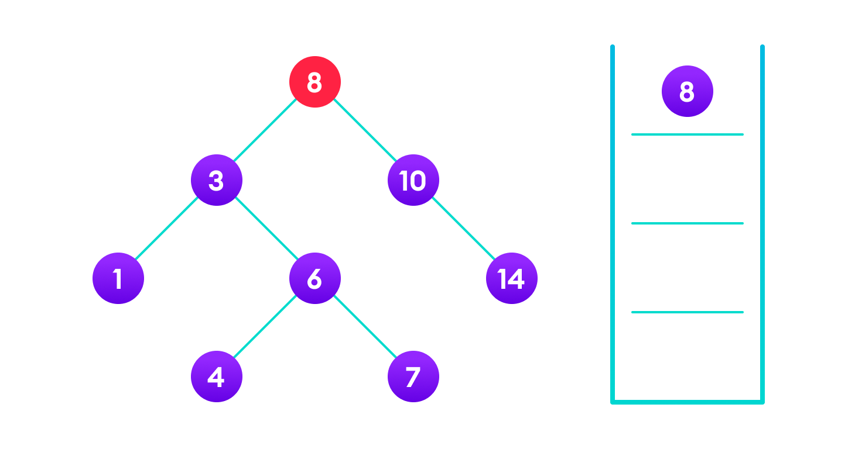
Binary Search Tree
Example of Search a node in BST
Find the value 4 from the given tree.
Step-1: 4 is not found and 4 < 8. So, traverse through the left subtree of 8

Slide 31
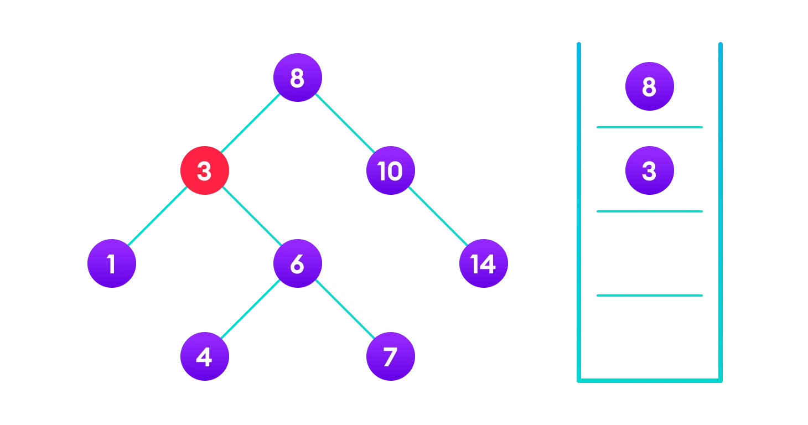
Binary Search Tree
Step-2: 4 is not found and 4 > 3. So, traverse through the right subtree of 3

Slide 32
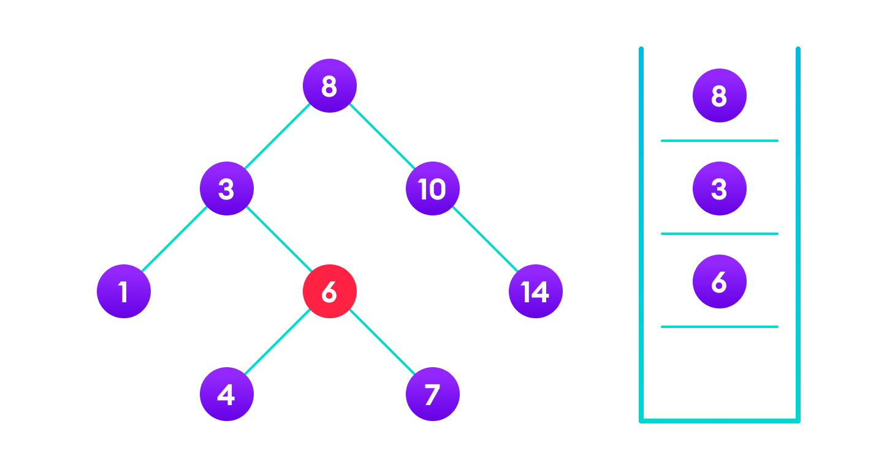
Binary Search Tree
Step-3: 4 is not found and 4 < 6. So, traverse through the left subtree of 6.

Slide 33

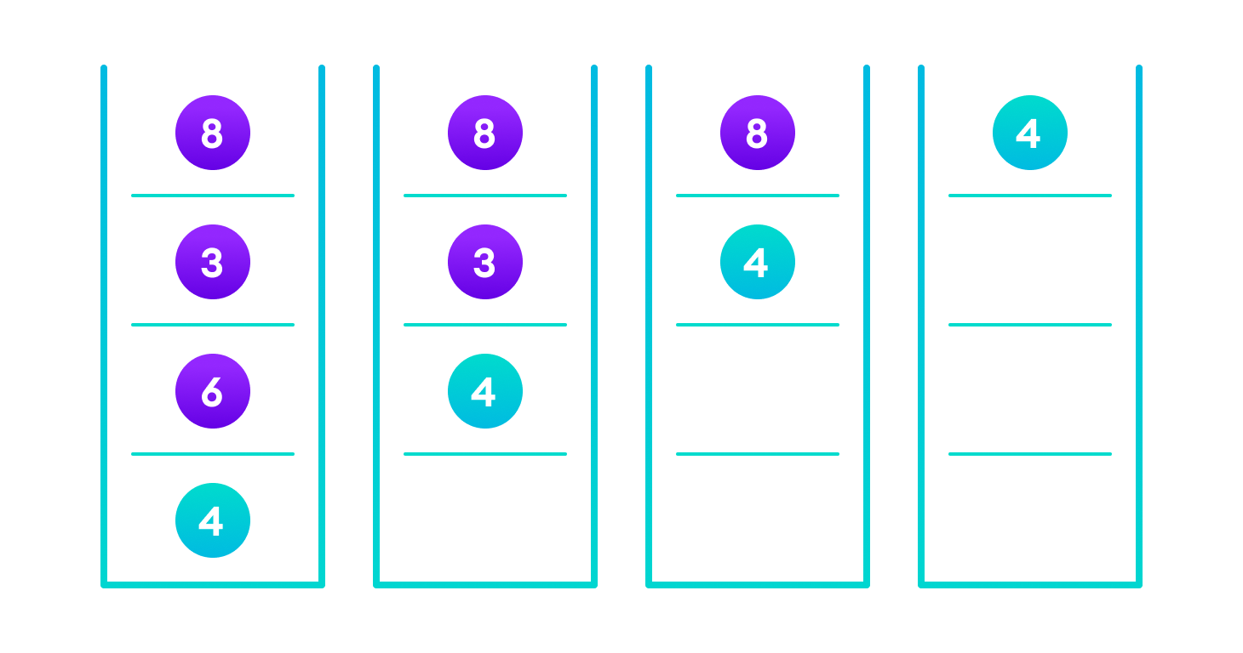
Binary Search Tree
Step-4: 4 is found.
✓

Slide 34
Binary Search Tree
If the value is found in any of the subtrees, it is propagated up so that in the end it is returned, otherwise null is returned.

Slide 35
Binary Search Tree
Insert a node in BST (Insertion)
Inserting a value in the correct position is similar to searching because we try to maintain the rule that the left subtree is lesser than root and the right subtree is larger than root.
We keep going to either right subtree or left subtree depending on the value and when we reach a point left or right subtree is null, we put the new node there.

Slide 36
Binary Search Tree
Algorithm of Insert a Node in BST
If (node == NULL)
return createNode(data);
if (data < node->data)
node->left = insert(node->left, data);
else if (data > node->data)
node->right = insert(node->right, data);
return node;

Slide 37
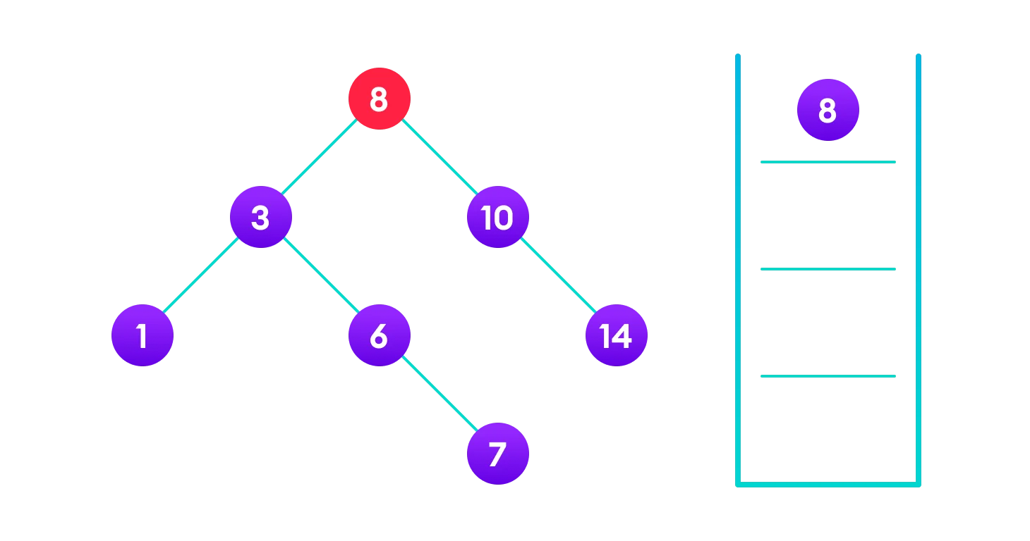
Binary Search Tree
Example of Insert a node in BST
Insert the value 4 from the given tree.
Step-1: 4 < 8 so, transverse through the left child of 8.

Slide 38
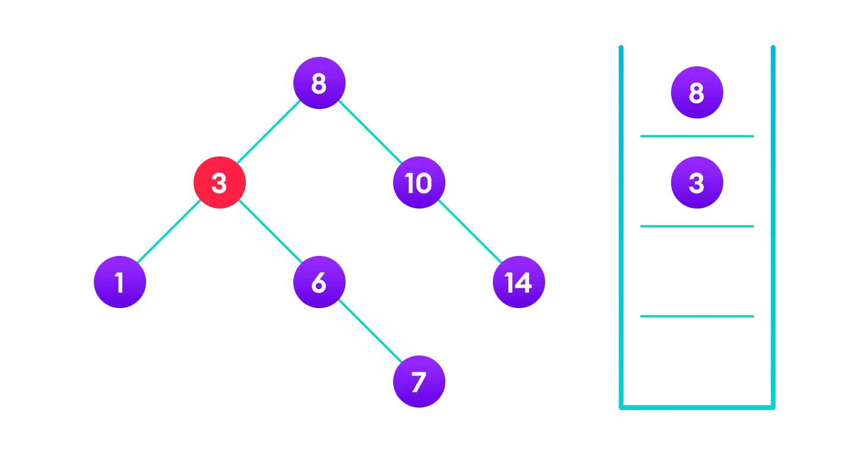
Binary Search Tree
Step-2: 4 > 3 so, transverse through the right child of 8.

Slide 39
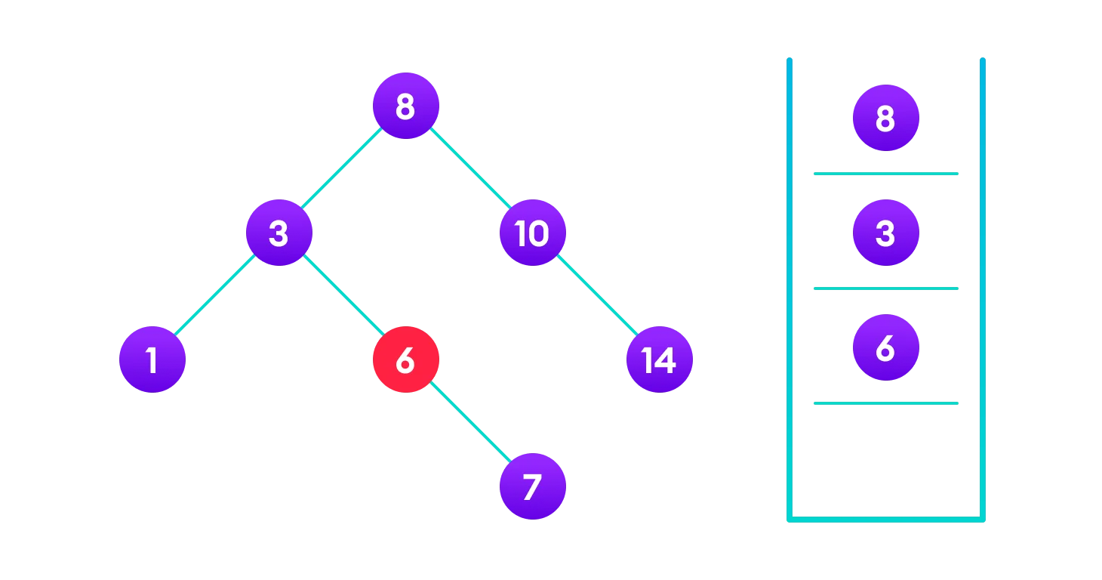
Binary Search Tree
Step-3: 4 < 6 so, transverse through the left child of 6.

Slide 40
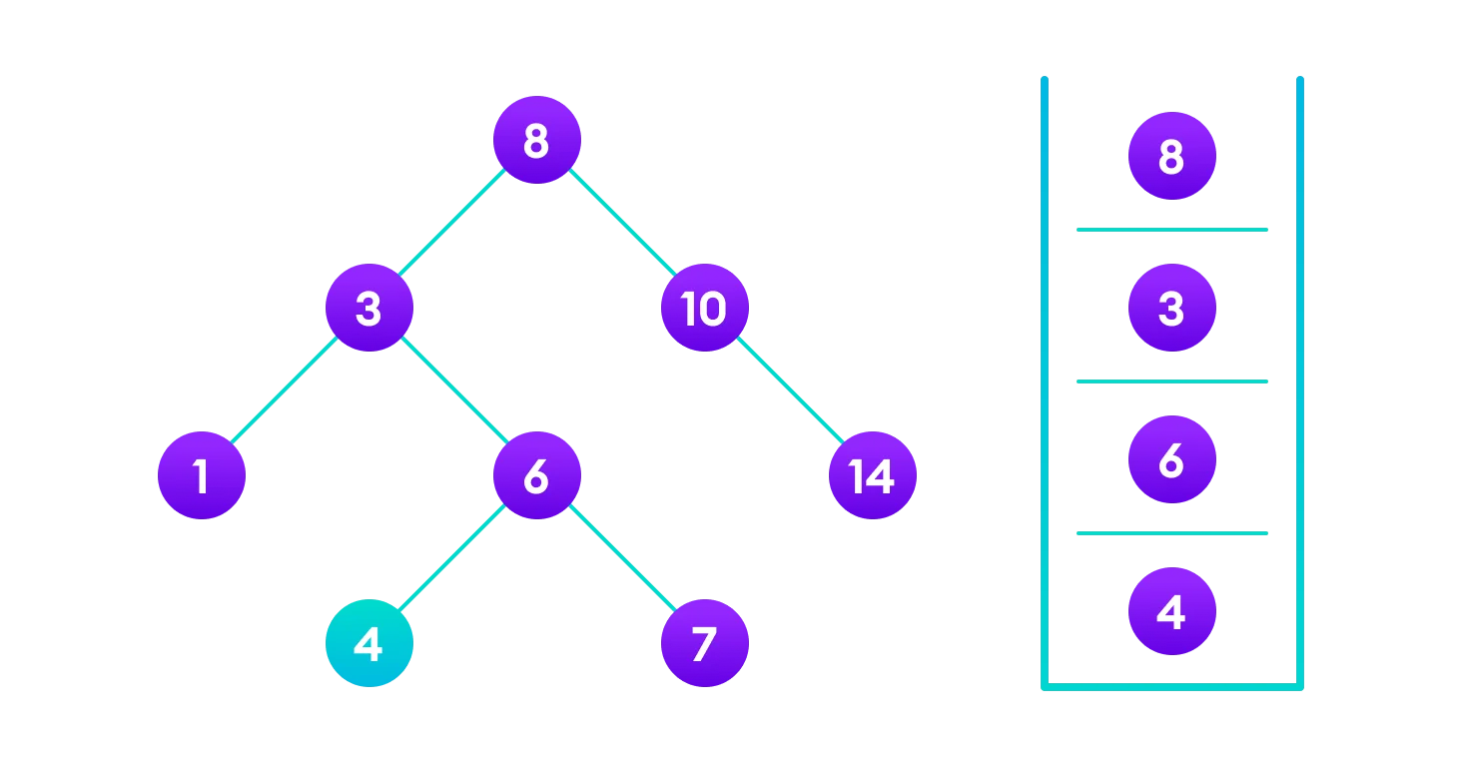
Binary Search Tree
Step-4: Insert 4 as a left child of 6.

Slide 41
Binary Search Tree
Delete a node in BST (Insertion)
There are three cases for deleting a node from a binary search tree.
Case 1: Delete a leaf node.
Case 2: Delete a node has a single child node.
Case 3: Delete a node has two child node.

Slide 42
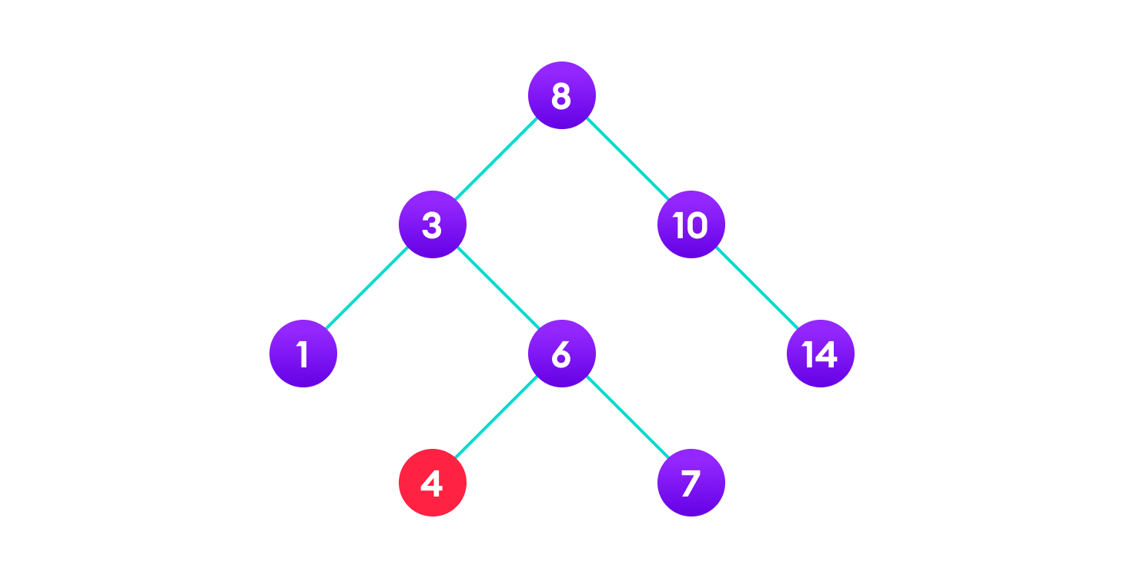
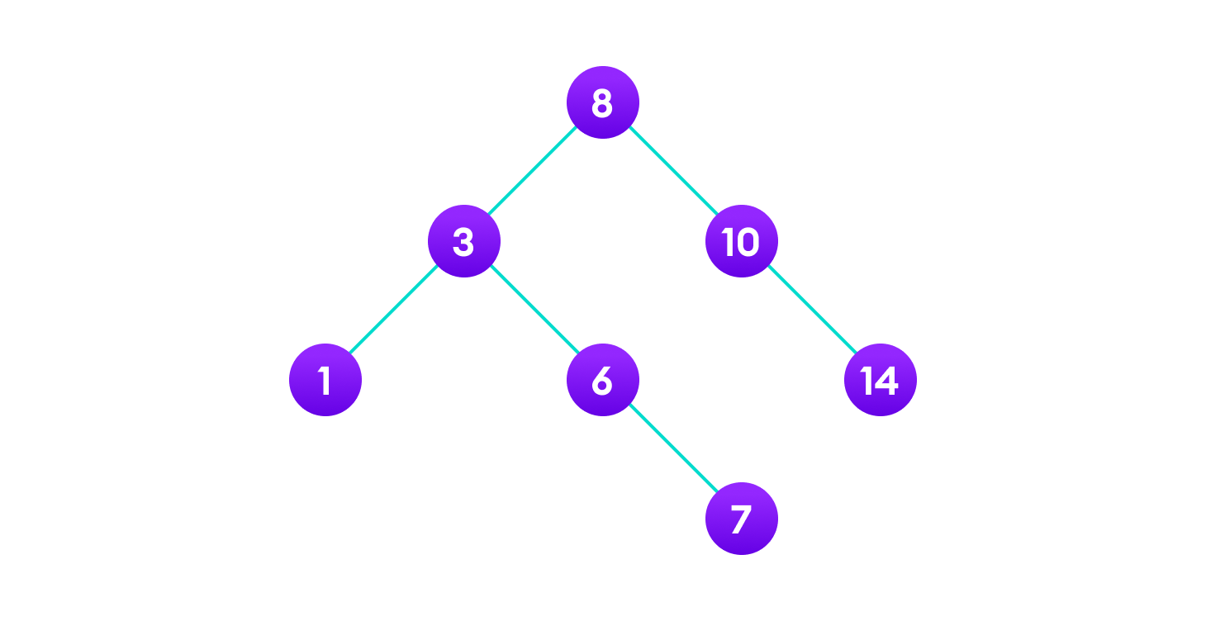
Binary Search Tree
Case 1: In the first case, the node to be deleted is the leaf node. In such a case, simply delete the node from the tree.
4 is to be deleted
Final tree

Slide 43
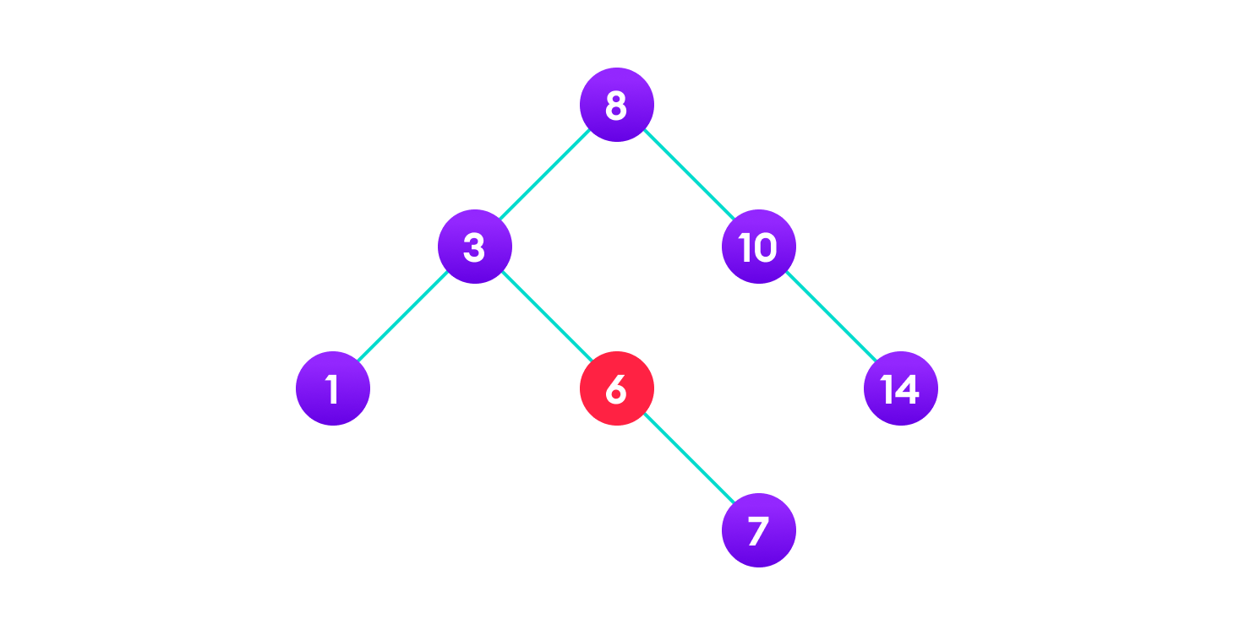
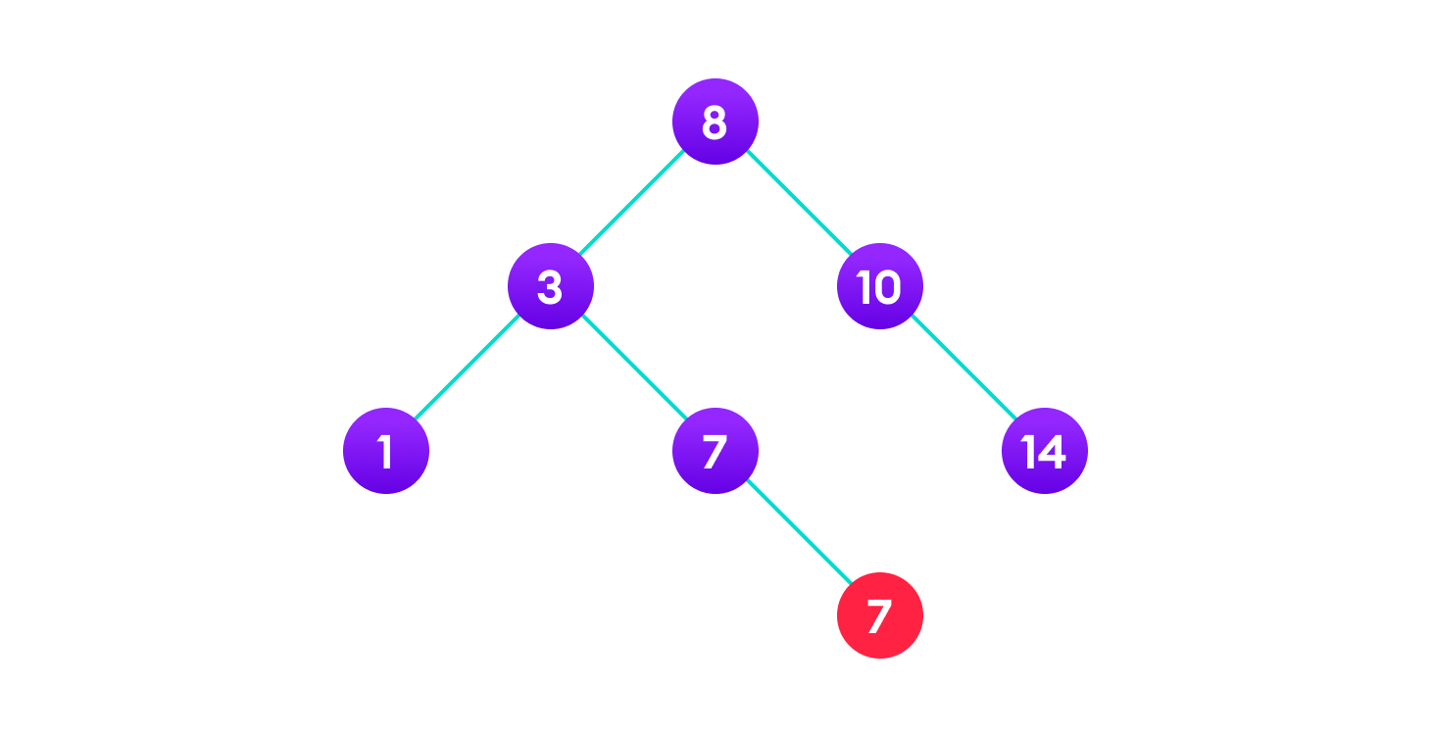
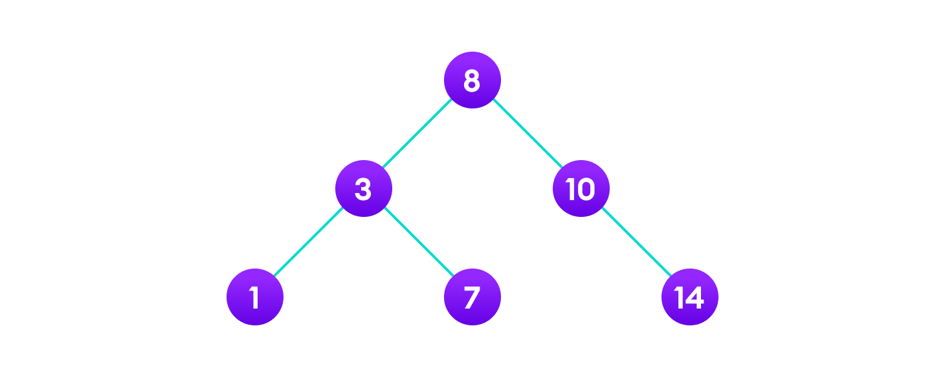
Binary Search Tree
Case 2: In the second case, the node to be deleted lies has a single child node. In such a case follow the steps below:
Replace that node with its child node.
Remove the child node from its original position.
6 is to be deleted
copy the value of its child to the node and delete the child
Final tree

Slide 44
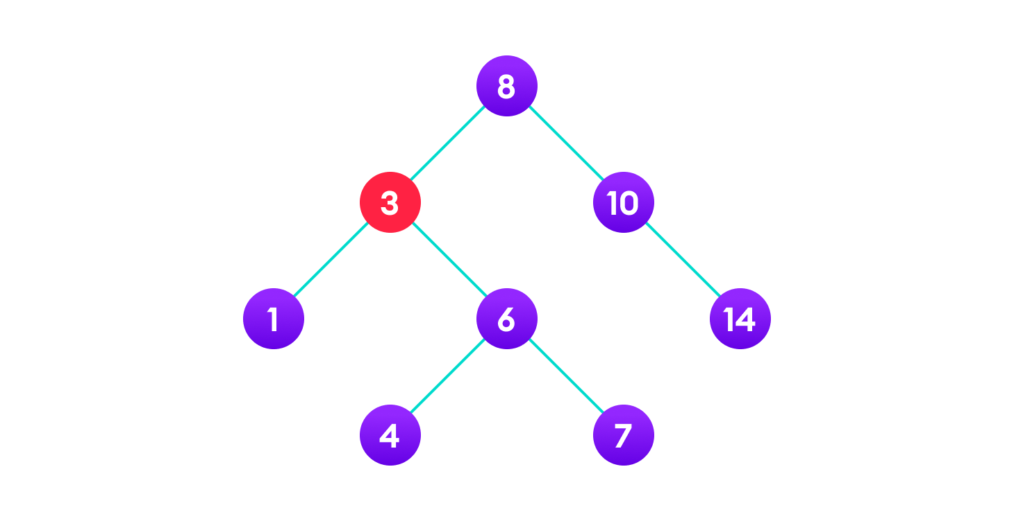

Binary Search Tree
Case 3: In the third case, the node to be deleted has two children. In such a case follow the steps below:
Get the inorder successor of that node.
Replace the node with the inorder successor.
Remove the inorder successor from its original position.
3 is to be deleted
Copy the value of the inorder successor (4) to the node
Delete the inorder successor

Slide 45
Binary Tree Traversal Method

Slide 46
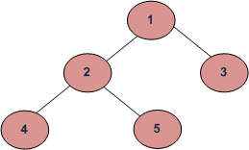
Binary Tree Traversal Method
Traversing a tree means visiting every node in the tree.
We have already learn BFS & DFS concepts in graph. Let’s discuss how this concept apply in tree data structure.
BFS (Breadth First Traversal) or Level Order Traversal
1 2 3 4 5 or 1 2 3 5 4 or 1 3 2 4 5 or 1 3 2 5 4
Depth First Traversals:
Preorder Traversal : 1 2 4 5 3
In order Traversal : 4 2 5 1 3
Post order Traversal : 4 5 2 3 1
Write the DFS & BFS of given tree.

Slide 47
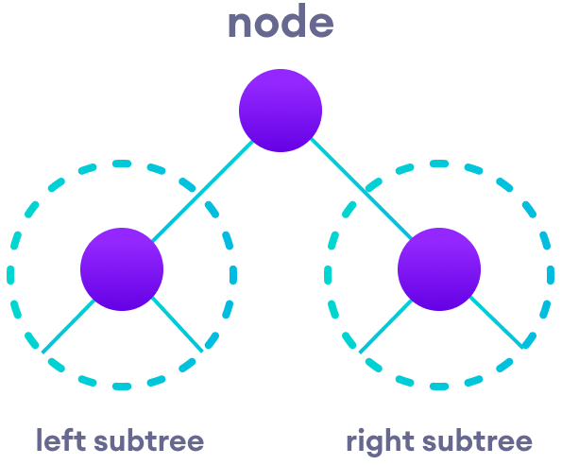
Binary Tree Traversal Method
According to this structure, every tree is a combination of
A node carrying data
Two subtrees
There are 3 methods of binary tree traversal:
Preorder Traversal (Root, Left, Right)
Inorder Traversal (Left, Root, Right)
Postorder Traversal (Left, Right, Root)

Slide 48
Binary Tree Traversal Method
Preorder Traversal (Root, Left, Right)
Preorder traversal of a binary tree is defined as follow
Process the root node
Traverse the left subtree in preorder
Traverse the right subtree in preorder
A
✓
B
✓
D
✓
C
✓
E
✓
G
✓
Algorithm
Step 1: Repeat step 2 to 4 while TREE != NULL
Step 2: Write “TREE->DATA”
Step 3: PREORDER(TREE->LEFT)
Step 4: PREORDER(TREE->RIGHT)
[END OF WHILE]
Step 5: END
F
✓
Preorder traversal of a given tree as
A
B
C
D
E
F
G

Slide 49
Binary Tree Traversal Method
Inorder Traversal (Left, Root, Right)
In order traversal of a binary tree is defined as follow
Traverse the left subtree in Inorder
Process the root node
Traverse the right subtree in Inorder
A
✓
B
✓
D
✓
C
✓
E
✓
G
✓
Algorithm
Step 1: Repeat step 2 to 4 while TREE != NULL
Step 2: INORDER(TREE->LEFT)
Step 3: Write “TREE->DATA”
Step 4: INORDER(TREE->RIGHT)
[END OF WHILE]
Step 5: END
F
✓
Inorder traversal of a given tree as
C
B
A
E
F
D
G

Slide 50
Binary Tree Traversal Method
Postorder Traversal (Left, Right, Root)
Postorder traversal of a binary tree is defined as follow
Traverse the left subtree in Postorder
Traverse the right subtree in Postorder
Process the root node
A
✓
B
✓
D
✓
C
✓
E
✓
G
✓
Algorithm
Step 1: Repeat step 2 to 4 while TREE != NULL
Step 2: POSTORDER(TREE->LEFT)
Step 4: POSTORDER(TREE->RIGHT)
Step 3: Write “TREE->DATA”
[END OF WHILE]
Step 5: END
F
✓
Postorder traversal of a given tree as
C
B
F
E
G
D
A

Slide 51
Binary Tree Traversal Method
Example: Write Preorder, Inorder and Postorder Traversal of given tree.
1
50
10
2
3
25
75
3
15
6
22
4
22
40
60
80
5
45
5
15
30
90
23
65
Preorder: 50 25 22 15 40 30 75 60 80 90
Inorder: 15 22 25 30 40 50 60 75 80 90
Postorder: 15 22 30 40 25 60 90 80 75 50
Preorder: 1 2 3 4 5
Inorder: 2 1 4 5 3
Postorder: 2 5 4 3 1
34
78
Preorder: 10 3 6 5 15 22 45 23 34 65 78
Inorder: 3 5 6 10 15 22 23 34 45 65 78
Postorder: 5 6 3 34 23 78 65 45 22 15 10

Slide 52
Binary Tree Traversal Method: Exercise
Generate a binary search tree and perform Preorder, Inorder & Postorder.
60 38 71 30 40 65 88 22 32 39 45 62 67 85 90 11 18 35 70
70 40 81 38 49 75 91 30 47 50 77 89 98 45
42 31 67 30 11 35 49 27 74 56

Slide 53

Binary Tree Traversal Method
60 38 71 30 40 65 88 22 32 39 45 62 67 85 90 11 18 35 70
Preorder: 60, 38, 30, 22, 11, 18, 32, 35, 40, 39, 45, 71, 65, 62, 67, 70, 88, 85,90
Inorder: 11, 18, 22, 30, 32, 35, 38, 39, 40, 45, 60, 62, 65, 67, 70, 71, 85, 88, 90
Postorder: 18, 11, 22, 35, 32, 30, 39, 45, 40, 38, 62, 70, 67, 65, 85, 90, 88, 71, 60

Slide 54
Binary Tree Traversal Method
70 40 81 38 49 75 91 30 47 50 77 89 98 45
Preorder: 70, 40, 38, 30, 49, 47, 45, 50, 81, 75, 77, 91, 89, 98
Inorder: 30, 38, 40, 45, 47, 49, 50, 75, 77, 81, 89, 91, 98
Postorder: 30, 38, 45, 47, 50, 49, 40, 77, 75, 89, 98, 91, 81, 70

Slide 55
Binary Tree Traversal Method
42 31 67 30 11 35 49 27 74 56
Preorder: 42, 31, 30, 11, 27, 35, 67, 49, 56, 74
Inorder: 11, 27, 30, 31, 35, 42, 49, 56, 67, 74
Postorder: 27, 11, 30, 35, 31, 56, 49, 74, 67, 42

Slide 56
Create a Binary Tree Using Preorder & Inorder
Generate a binary search tree and from given Data.
Preorder – 15, 11, 9, 13, 20, 18
Inorder - 9, 11, 13, 15, 18, 20
Step-1: In the first step, we will create the tree's root, and initially, the index will be at the first of the preorder array.
15
Pre-order
Traversal
15
11
9
13
20
18
9
11
13
18
20
In-order
Traversal
9
11
13
15
18
20
Left Subtree
Right Subtree

Slide 57
Create a Binary Tree Using Preorder & Inorder
Step-2: In the second step, we will first create the left subtree, and our preorder index will be incremented, and point to 11, and 11 will be the root of the left subtree.
15
Pre-order
Traversal
15
11
9
13
20
18
11
18
20
In-order
Traversal
9
11
13
15
18
20
LS
RS
9
13

Slide 58
Create a Binary Tree Using Preorder & Inorder
Step-3: In the third step, the left and right child of the left subtree will be created. We will create the left subtree first, and after that, we will create right subtree. So the left subtree consist of only a single node, so only 9 will be created and preindex will be incremented.
15
Pre-order
Traversal
15
11
9
13
20
18
11
18
20
In-order
Traversal
9
11
13
15
18
20
9
13

Slide 59
Create a Binary Tree Using Preorder & Inorder
Step-4: In the fourth step, we will create right subtree, consisting of only a single node. i.e., 13, so here, the preindex will decrease and point to 13.
15
Pre-order
Traversal
15
11
9
13
20
18
11
18
20
In-order
Traversal
9
11
13
15
18
20
9
13

Slide 60
Create a Binary Tree Using Preorder & Inorder
Step-5: Since we have created the left subtree, it is time to create the right subtree of the root node. So we will create the root node of the right subtree, i.e., 20, so here, the preindex will increase and point to 20.
15
Pre-order
Traversal
15
11
9
13
20
18
11
20
In-order
Traversal
9
11
13
15
18
20
LS
13
9
18

Slide 61
Create a Binary Tree Using Preorder & Inorder
Step-6: In the last step, we will create the left subtree of node 20, consisting of only a single node. In this step, preindex will be incremented, now pointing to the last element.
15
Pre-order
Traversal
15
11
9
13
20
18
11
20
In-order
Traversal
9
11
13
15
18
20
9
13
18

Slide 62
Create a BST from Preorder, Inorder & Postorder
Generate a binary search tree and from given Data.
Preorder – 38, 19, 16, 11, 17, 24, 57, 61, 60
In order - 11, 16 17, 19, 24, 38, 57, 60, 61
Preorder – 29, 18, 10, 25, 19, 27, 58, 42, 35, 63
In order - 10, 18, 19, 25, 27, 29, 42, 45, 58, 63

Slide 63
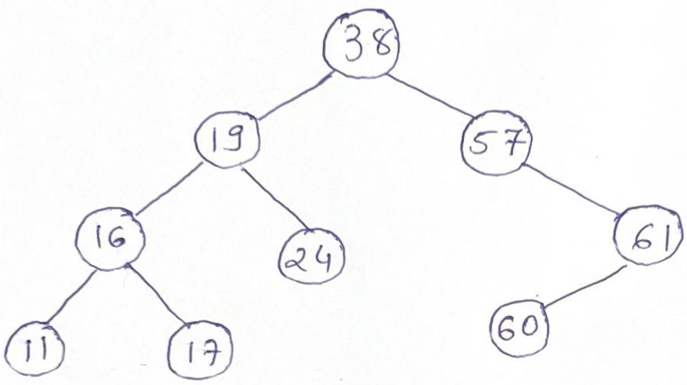
Create a BST from Preorder, Inorder & Postorder
Generate a binary search tree and from given Data.
Preorder – 38, 19, 16, 11, 17, 24, 57, 61, 60
In order - 11, 16 17, 19, 24, 38, 57, 60, 61

Slide 64
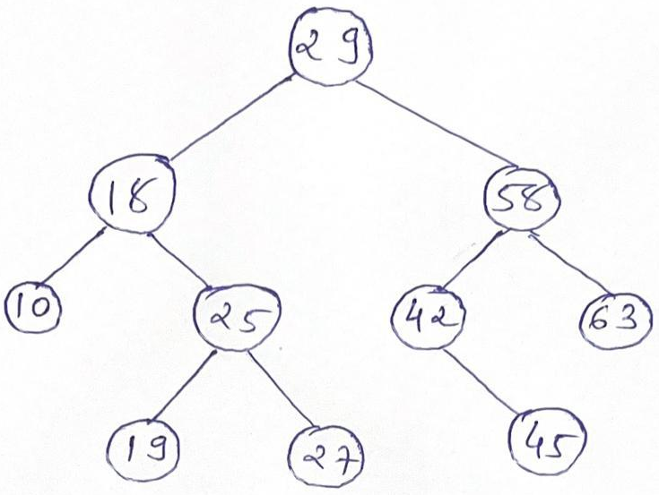
Create a BST from Preorder, Inorder & Postorder
Generate a binary search tree and from given Data.
Preorder – 29, 18, 10, 25, 19, 27, 58, 42, 35, 63
In order - 10, 18, 19, 25, 27, 29, 42, 45, 58, 63

Slide 65
Create a Binary Tree Using Postorder & Inorder
Generate a binary search tree and from given Data.
Postorder – 9, 13, 11, 18, 20, 15
Inorder - 9, 11, 13, 15, 18, 20
Step-1: In the first step, we will create the tree's root, and initially, the index will be at the last of the post-order array.
15
Post-order
Traversal
9
13
11
18
20
15
9
11
13
18
20
In-order
Traversal
9
11
13
15
18
20
Left Subtree
Right Subtree

Slide 66
Create a Binary Tree Using Postorder & Inorder
Step-2: In the second step, we will first create the right subtree, and our postindex will be decremented, and point to 20, and 20 will be the root of the right subtree.
15
Post-order
Traversal
9
13
11
18
20
15
9
11
13
20
In-order
Traversal
9
11
13
15
18
20
LS
18

Slide 67
Create a Binary Tree Using Postorder & Inorder
Step-3: In the third step, the left and right child of the right subtree will be created. There is no right child, so we will create only a left child, postindex will be decremented here. It will point to 18, so a node will a value of 18 will be created.
15
Post-order
Traversal
9
13
11
18
20
15
9
11
13
20
In-order
Traversal
9
11
13
15
18
20
18

Slide 68
Create a Binary Tree Using Postorder & Inorder
Step-4: Since we have created the right subtree, it is time to create the left subtree of the root node. So we will create the root node of the left subtree, i.e., 11, so here, the postindex will decrease and point to 11.
15
Post-order
Traversal
9
13
11
18
20
15
11
20
In-order
Traversal
9
11
13
15
18
20
LS
RS
9
13
18

Slide 69
Create a Binary Tree Using Postorder & Inorder
Step-5: Now, again we will repeat the above steps. We will create the right subtree first, and after that, we will create the left subtree (In the left subtree of the root node). So the right subtree consists of only a single node, so only 13 will be created, and postindex will be decremented.
15
Post-order
Traversal
9
13
11
18
20
15
11
20
In-order
Traversal
9
11
13
15
18
20
9
13
18

Slide 70
Create a Binary Tree Using Postorder & Inorder
Step-6: In the last step, we will create the left subtree, consisting of only a single node. In this step, postindex will be decremented, now pointing to the first element.
15
Post-order
Traversal
9
13
11
18
20
15
11
20
In-order
Traversal
9
11
13
15
18
20
9
13
18

Slide 71
Create a BST from Preorder, Inorder & Postorder
Generate a binary search tree and from given Data.
Postorder – 11, 17, 16, 24, 19, 60, 61, 57, 38
In order - 11, 16 17, 19, 24, 38, 57, 60, 61
Postorder – 10, 19, 27, 25, 18, 45, 42, 63, 58, 29
In order - 10, 18, 19, 25, 27, 29, 42, 45, 58, 63

Slide 72
Create a BST from Preorder, Inorder & Postorder
Generate a binary search tree and from given Data.
Postorder – 11, 17, 16, 24, 19, 60, 61, 57, 38
In order - 11, 16 17, 19, 24, 38, 57, 60, 61

Slide 73
Create a BST from Preorder, Inorder & Postorder
Generate a binary search tree and from given Data.
Postorder – 10, 19, 27, 25, 18, 45, 42, 63, 58, 29
In order - 10, 18, 19, 25, 27, 29, 42, 45, 58, 63

Slide 74
Method to convert General Tree to Binary Tree

Slide 75
Method to convert General tree to Binary Tree
Rules to follow while conversion from General tree to Binary tree
Root of the General tree = Root of the Binary Tree
Left child of the node in Binary Tree = Most left child of the General Tree
Right child of the node in Binary Tree = Right sibling of that node in General Tree

Slide 76
Method to convert General tree to Binary Tree
Example – 1:
a
a
a
b
b
f
b
f
f
c
g
d
c
d
g
j
k
c
d
g
j
k
h
j
e
e
h
i
e
h
i
i
k

Slide 77
Method to convert General tree to Binary Tree
Example – 2: Convert forest into binary tree
a
g
a
b
c
h
i
b
g
d
e
f
j
k
l
d
c
h
a
g
j
i
e
b
c
h
i
f
k
l
d
e
f
j
k
l

Slide 78
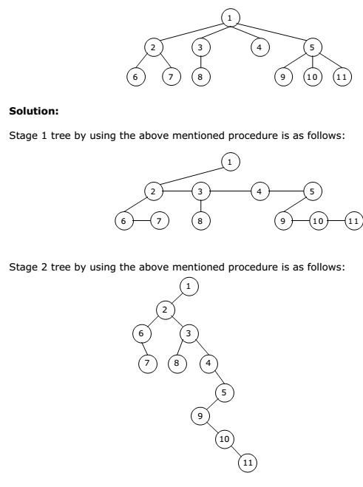
Method to convert General tree to Binary Tree
Example – 3:

Slide 79
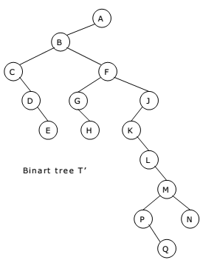
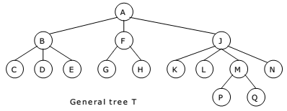
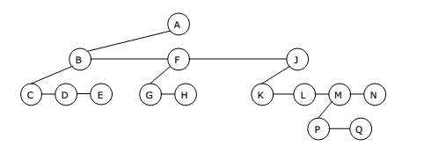
Method to convert General tree to Binary Tree
Example – 4:

Slide 80
Threaded Binary Tree

Slide 81
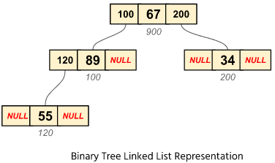
Threaded Binary Tree
Here we will see the threaded binary tree data structure. We know that the binary tree nodes may have at most two children. But if they have only one children, or no children, the link part in the linked list representation remains null. Using threaded binary tree representation, we can reuse that empty links by making some threads.

Slide 82
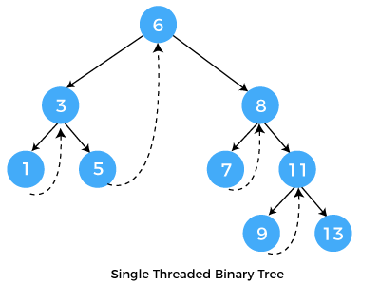

Threaded Binary Tree
If one node has some vacant left or right child area, that will be used as thread. There are two types of threaded binary tree: single (one-way) threaded tree or fully (two-way) threaded binary tree.
In single threaded mode, there are another two variations. Left threaded and right threaded.

Slide 83
Threaded Binary Tree
In the left threaded mode if some node has no left child, then the left pointer will point to its inorder predecessor
Similarly in the right threaded mode if some node has no right child, then the right pointer will point to its inorder successor.
In both cases, if no successor or predecessor is present, then it will point to header node.

Slide 84
Threaded Binary Tree
For fully threaded binary tree, each node has five fields. Three fields like normal binary tree node, another two fields to store value to denote whether link of that side is actual link or thread.

Slide 85
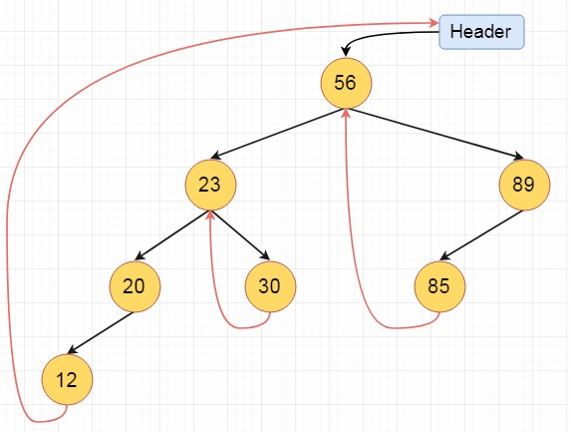
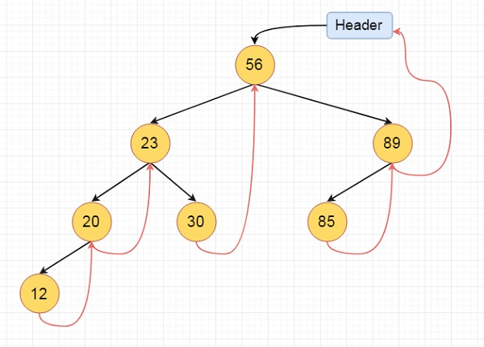
Threaded Binary Tree
Example -1: 56, 23, 30, 89, 20, 85, 12 (Create Right & Left Threaded binary tree)

Slide 86
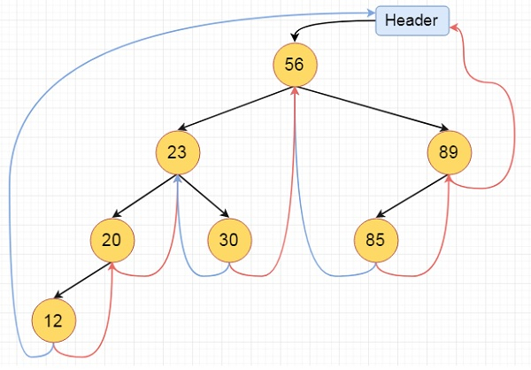
Threaded Binary Tree
Example -2: 56, 23, 30, 89, 20, 85, 12 (Create fully threaded binary tree)

Slide 87
Balanced Tree & its Mechanism

Slide 88
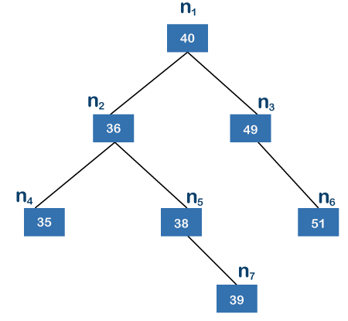
Balanced Tree & its mechanism
A balanced binary tree is also known as height balanced tree.
It is defined as binary tree in when the difference between the height of the left subtree and right subtree is not more than m, where m is usually equal to 1. The height of a tree is the number of edges on the longest path between the root node and the leaf node.
The n7 node is the farthest node from the root node. The n4 and n6 contain 2 edges and there exist three edges between the root node and n7 node.
Since n7 is the farthest from the root node; therefore, the height of the above tree is 3.

Slide 89
Balanced Tree & its mechanism
Now we will see whether the tree is balanced or not.
The left subtree contains the nodes n2, n4, n5, and n7, while the right subtree contains the nodes n3 and n6.
The left subtree has two leaf nodes, i.e., n4 and n7.
There is only one edge between the node n2 and n4 and two edges between the nodes n7 and n2; therefore, node n7 is the farthest from the root node. The height of the left subtree is 2.
The right subtree contains only one leaf node, i.e., n6, and has only one edge; therefore, the height of the right subtree is 1.

Slide 90
Balanced Tree & its mechanism
Difference = Height of Left Subtree – Height of Right subtree
Difference must be 1 or 0 is consider as balanced tree, otherwise unbalanced tree.
The difference between the heights of the left subtree and right subtree is 1.
Since we got the value 1 so we can say that the above tree is a height-balanced tree.

Slide 91
AVL Tree

Slide 92
AVL Tree
AVL Tree is invented by GM Adelson - Velsky and EM Landis in 1962. The tree is named AVL in honour of its inventors.
AVL Tree can be defined as height balanced binary search tree in which each node is associated with a balance factor which is calculated by subtracting the height of its right sub-tree from that of its left sub-tree.
Balance Factor (k) = height (left(k)) - height (right(k))
Tree is said to be balanced if balance factor of each node is in between -1 to 1, otherwise, the tree will be unbalanced and need to be balanced.

Slide 93
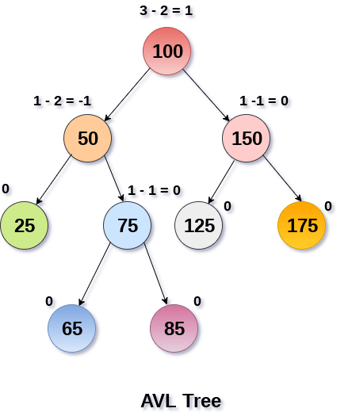
AVL Tree
Balance Factor (k) = height (left(k)) - height (right(k))
If balance factor of any node is 1, it means that the left sub-tree is one level higher than the right sub-tree.
If balance factor of any node is 0, it means that the left sub-tree and right sub-tree contain equal height.
If balance factor of any node is -1, it means that the left sub-tree is one level lower than the right sub-tree.
An AVL tree is given in the figure. We can see that, balance factor associated with each node is in between -1 and +1. therefore, it is an example of AVL tree.

Slide 94
AVL Tree
AVL Tree is invented by GM Adelson - Velsky and EM Landis in 1962. The tree is named AVL in honour of its inventors.
AVL Tree can be defined as height balanced binary search tree in which each node is associated with a balance factor which is calculated by subtracting the height of its right sub-tree from that of its left sub-tree.
Balance Factor (k) = height (left(k)) - height (right(k))
Tree is said to be balanced if balance factor of each node is in between -1 to 1, otherwise, the tree will be unbalanced and need to be balanced.

Slide 95
AVL Tree
Operation perform in AVL Tree: Insertion & Deletion
Insertion: Insertion in AVL tree is performed in the same way as it is performed in a binary search tree. However, it may lead to violation in the AVL tree property and therefore the tree may need balancing. The tree can be balanced by applying rotations.
Deletion: Deletion can also be performed in the same way as it is performed in a binary search tree. Deletion may also disturb the balance of the tree therefore, various types of rotations are used to rebalance the tree.

Slide 96
AVL Rotation
We perform rotation in AVL tree only in case if Balance Factor is other than -1, 0, and 1. There are basically four types of rotations which are as follows:
L L rotation: Inserted node is in the left subtree of left subtree of A.
R R rotation: Inserted node is in the right subtree of right subtree of A.
L R rotation: Inserted node is in the right subtree of left subtree of A.
R L rotation: Inserted node is in the left subtree of right subtree of A.
The first two rotations LL and RR are single rotations.
The next two rotations LR and RL are double rotations.
For a tree to be unbalanced, minimum height must be at least 2, Let us understand each rotation

Slide 97
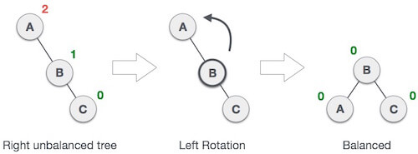
AVL Rotation
RR Rotation:
When BST becomes unbalanced, due to a node is inserted into the right subtree of the right subtree of A, then we perform RR rotation, RR rotation is an anticlockwise rotation, which is applied on the edge below a node having balance factor -2.
In above example, node A has balance factor -2 because a node C is inserted in the right subtree of A right subtree. We perform the RR rotation on the edge below A.

Slide 98
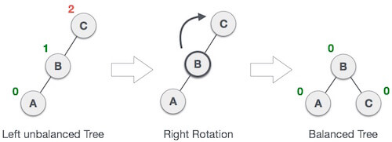
AVL Rotation
LL Rotation:
When BST becomes unbalanced, due to a node is inserted into the left subtree of the left subtree of C, then we perform LL rotation, LL rotation is clockwise rotation, which is applied on the edge below a node having balance factor 2.
In above example, node C has balance factor 2 because a node A is inserted in the left subtree of C left subtree. We perform the LL rotation on the edge below A.

Slide 99
AVL Rotation
LR Rotation:
Double rotations are bit tougher than single rotation which has already explained.
LR rotation = RR rotation + LL rotation, i.e., first RR rotation is performed on subtree and then LL rotation is performed on full tree, by full tree we mean the first node from the path of inserted node whose balance factor is other than -1, 0, or 1.

Slide 100
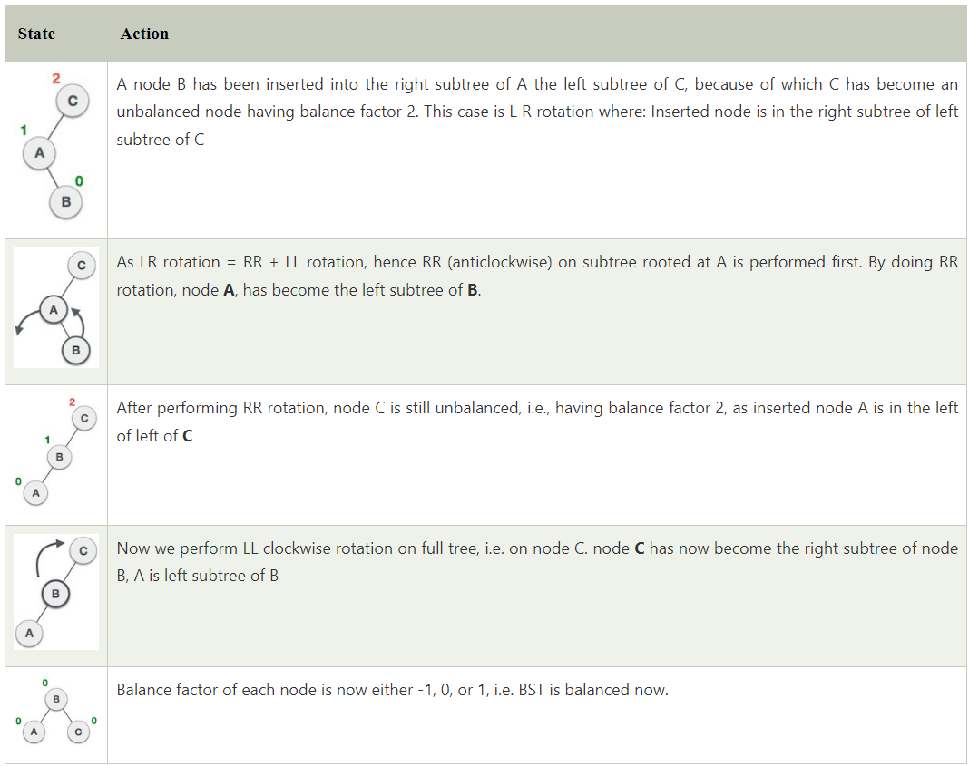
AVL Rotation
LR Rotation:
Let us understand each and every step very clearly:

Slide 101
AVL Rotation
RL Rotation:
As already discussed, that double rotations are bit tougher than single rotation which has already explained.
R L rotation = LL rotation + RR rotation, i.e., first LL rotation is performed on subtree and then RR rotation is performed on full tree, by full tree we mean the first node from the path of inserted node whose balance factor is other than -1, 0, or 1.

Slide 102
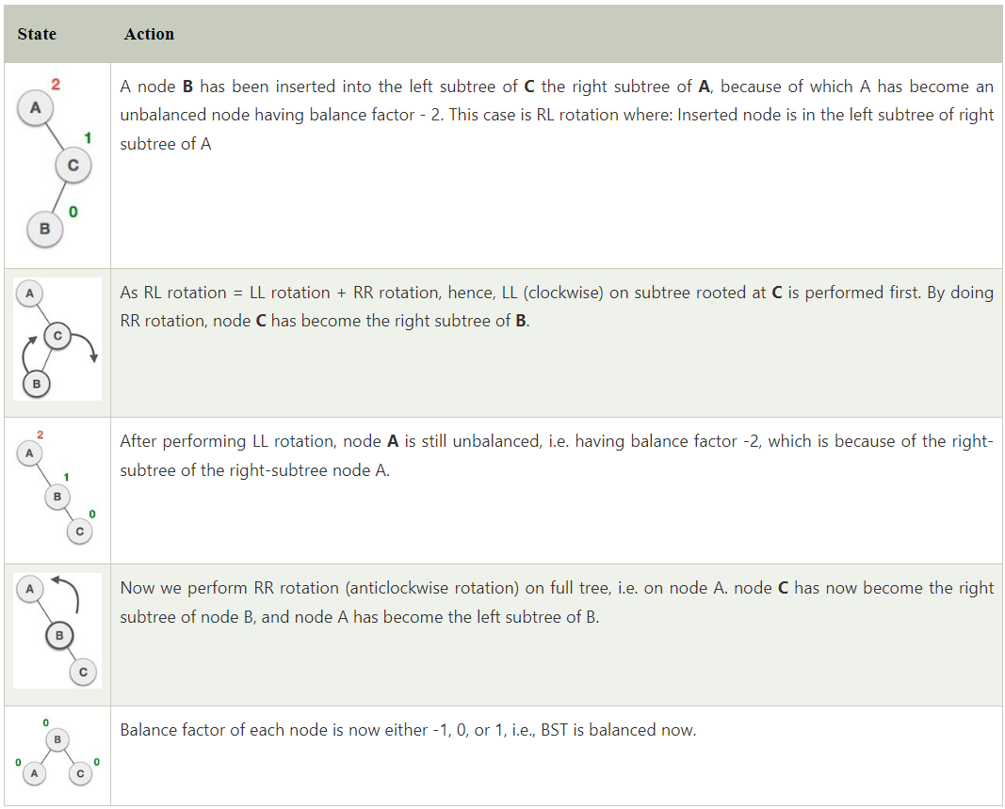
AVL Rotation
RL Rotation:
Let us understand each and every step very clearly:

Slide 103
B Tree & B+ Tree

Slide 104
How to construct B Tree?
Operation perform in AVL Tree: Insertion & Deletion
If the B tree has an order of m, then each node can have a maximum of m. In the case of minimum children, the leaf nodes have zero children, the root node has two children, and the internal nodes have a ceiling of m/2.
Each node can have maximum (m-1) keys. For example, if the value of m is 5 then the maximum value of keys is 4.
The root node has minimum one key, whereas all the other nodes except the root node have (ceiling of m/2 - 1) minimum keys.
If we perform insertion in the B tree, then the node is always inserted in the leaf node.

Slide 105
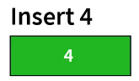
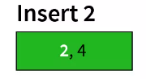
Example of B Tree
Example: Suppose we have to create a B tree of order 3. The elements to be inserted are 4, 2, 20, 10, 1, 14, 7, 11, 3, 8.
Here m=3, max number of keys for a node = m-1 = 2.
Step-1: Insert 4.
Step-2: Since 2<4, insert 2 to the left of 4 in the same node.

Slide 106
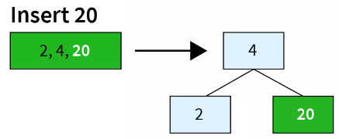
Example of B Tree
Example: Suppose we have to create a B tree of order 3. The elements to be inserted are 4, 2, 20, 10, 1, 14, 7, 11, 3, 8.
Here m=3, max number of keys for a node = m-1 = 2.
Step-3: Since 20>4, insert 20 to the right of 4 in the same node. As we now, maximum number of keys in the node are 2, one of these keys will have to be moved to a node above to split it. 4 being the middle element will move up and 2 and 20 will be its left and right nodes respectively.

Slide 107

Example of B Tree
Example: Suppose we have to create a B tree of order 3. The elements to be inserted are 4, 2, 20, 10, 1, 14, 7, 11, 3, 8.
Here m=3, max number of keys for a node = m-1 = 2.
Step-4: 10>4 and 10<20 and thus, 10 will be inserted as a key in the node that contains 20 as a key.

Slide 108

Example of B Tree
Example: Suppose we have to create a B tree of order 3. The elements to be inserted are 4, 2, 20, 10, 1, 14, 7, 11, 3, 8.
Here m=3, max number of keys for a node = m-1 = 2.
Step-5: Since 1<2, it will be inserted as a key in the node that contains 2 as a key.

Slide 109

Example of B Tree
Example: Suppose we have to create a B tree of order 3. The elements to be inserted are 4, 2, 20, 10, 1, 14, 7, 11, 3, 8.
Here m=3, max number of keys for a node = m-1 = 2.
Step-6: 14>10 and 14<20. Since the number of keys in that node exceeds the maximum number of keys, the node will split after the middle key moves upto the node in the above line. Thus, 14 gets added to the right of 4 in the node that contains 4, and 10 and 20 are split as 2 separate nodes.

Slide 110

Example of B Tree
Example: Suppose we have to create a B tree of order 3. The elements to be inserted are 4, 2, 20, 10, 1, 14, 7, 11, 3, 8.
Here m=3, max number of keys for a node = m-1 = 2.
Step-7: Since 7<10, it gets inserted to the left in the node that contains 10 as a key.

Slide 111

Example of B Tree
Example: Suppose we have to create a B tree of order 3. The elements to be inserted are 4, 2, 20, 10, 1, 14, 7, 11, 3, 8.
Here m=3, max number of keys for a node = m-1 = 2.
Step-8: 11<14 and 11>10. Thus, 11 should get added to the right of the node that contains 7 and 10. However, since the maximum number of keys in the tree are 2, a split should take place. Thus, the middle element 10 moves to the above node and 7 and 11 split as separate nodes. The above node now contains 4, 10 and 14. Since the count of keys exceeds the maximum key count, there would be a split there. Now, 10 is the root node with 4 and 14 as its children.

Slide 112

Example of B Tree
Example: Suppose we have to create a B tree of order 3. The elements to be inserted are 4, 2, 20, 10, 1, 14, 7, 11, 3, 8.
Here m=3, max number of keys for a node = m-1 = 2.
Step-9: Since 3<4 and 3>2,it gets inserted to the right of the node containing 1, 2. This node exceeds the maximum count of keys in a node, leading to a split. 2 is added to the upper node beside 4.

Slide 113

Example of B Tree
Example: Suppose we have to create a B tree of order 3. The elements to be inserted are 4, 2, 20, 10, 1, 14, 7, 11, 3, 8.
Here m=3, max number of keys for a node = m-1 = 2.
Step-10: Since 8>7 and 8<10, it gets added to the left of the node that contains 7 as a key.

Slide 114

How to construct B+ Tree?
The most well-known version of the B-tree is the B+tree. What distinguishes the B+tree from the B-tree are two main aspects:
all leaf nodes are linked together in a doubly-linked list.
satellite data is stored on the leaf nodes only. Internal nodes only hold keys and act as routers to the correct leaf node.
Let’s see how our B-tree would look like if we were to represent its content as a B+tree:

Slide 115


How to construct B+ Tree?
Example: Create a B+ Tree of given data: 1, 2, 3, 4, 5, 6, 7, 8, 9, 10.
Step-1: Insert 1 & 2.
Step-2: Insert 3.

Slide 116

How to construct B+ Tree?
Example: Create a B+ Tree of given data: 1, 2, 3, 4, 5, 6, 7, 8, 9, 10.
Step-3: Insert 4.

Slide 117

How to construct B+ Tree?
Example: Create a B+ Tree of given data: 1, 2, 3, 4, 5, 6, 7, 8, 9, 10.
Step-4: Insert 5.

Slide 118
How to construct B+ Tree?
Example: Create a B+ Tree of given data: 1, 2, 3, 4, 5, 6, 7, 8, 9, 10.
Step-5: Insert 6, 7, 8, 9, 10.

Slide 119
Application of Tree Data Structure

Slide 120
Application of Tree Data Structure
File Systems: The file system of a computer is often represented as a tree. Each folder or directory is a node in the tree, and files are the leaves.
XML Parsing: Trees are used to parse and process XML documents. An XML document can be thought of as a tree, with elements as nodes and attributes as properties of the nodes.
Database Indexing: Many databases use trees to index their data. The B-tree and its variations are commonly used for this purpose.
Compiler Design: The syntax of programming languages is often defined using a tree structure called a parse tree. This is used by compilers to understand the structure of the code and generate machine code from it.
Artificial Intelligence: Decision trees are often used in artificial intelligence to make decisions based on a series of criteria.

Slide 121
Application of Tree Data Structure
Databases use tree data structure for indexing.
Tree data structure is used in file directory management.
DNS uses tree data structure.
Trees are used in several games like moves in chess.
Decision-based algorithms in machine learning uses tree algorithms.

Slide 122

Thank
You

